Slide 1
Stages
Stage 1
Year 10 review options presentations and GCSE / Level 2 subject information online from the week beginning 13th January 2025
Stage 2
Parent meeting 4th of February Option sheet handed in 24th February 2025
Stage 3
Review of individual Option Sheets
Stage 4
Timetabling of courses commences by April 2025

Slide 2
GCSE Options (all are equivalent to level 2)
GCSEs
At least one exam that will be worth at least 50%
OCN NI
This is a form of level 2 qualification
No exams – all coursework
GCSE Occupational Studies
No exams – but there IS paper work such as evaluations to be done whether the Occupational Study is done in school or at the SRC
BTEC
BTECs are a form of level 2 qualification
They have at least one exam
Most of the marks come from coursework
May involve coursework worth between 20-60% depending on the course
Marked pass or fail
Marked Distinction (A) / Merit (B) or Pass (C)
Marked Distinction (A) / Merit (B) or Pass (C)
A Pass is the equivalent of a B at GCSE
Marked A-U

Slide 3
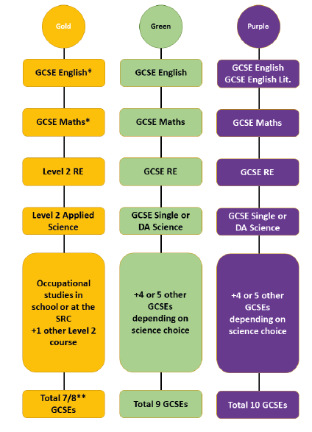
Mandatory
Optional

